Slide 1


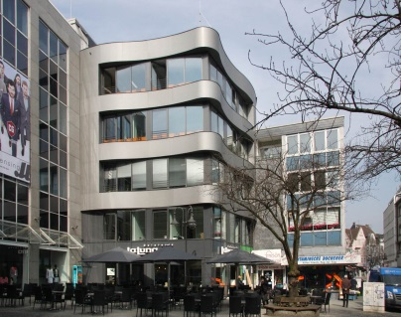

Technical Training Program
IIF & SFAI is proud to announce
Training Program on February 8, 2018 in collaboration with ISHRAE & Graco.
All with interest to begin & build their technical knowledge through interactive learning are welcome to the classroom & demo sessions. The course will introduce and cover all aspects of insulation.
02:00 – 02:15 PM Introductions Isaac Emmanuel, Covestro
02:15 – 02:45 PM Why Insulation? Benefits & K K Mitra, Lloyd Ins
Overcoming challenges
02:45 – 03:15 PM Designing & Achieving Energy M M Roy, Reliable Ins
Efficiency through Insulation
03:15 - 04:15 PM Understanding Spray Foam & its role Dr. Ashok Mhatre, Tea Expanded Polymer
04:30 – 05:00 PM Essentials of Machinery Sachin Bansal, Graco
for Spray Foam
05:00 – 05:30 PM Demo/sample All
05:30 – 05:45 PM Feedback & Wrap-up All
Venue: Graco India P Ltd,
295, Udyog Vihar Phase –IV ,
Gurugram , Haryana ,India
RSVP: Sachin Bansal -9999307610
Isaac Emmanuel -819854360
With the support of :

